Slide 1
Correlation analysis
Full movement

Slide 2
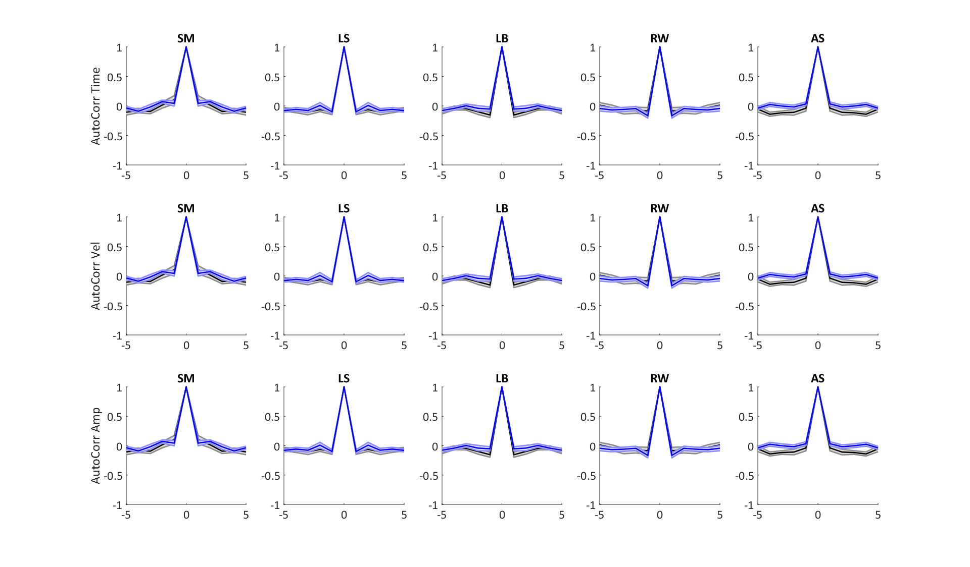
Auto correlation between drifts per trial in each condition

Slide 3
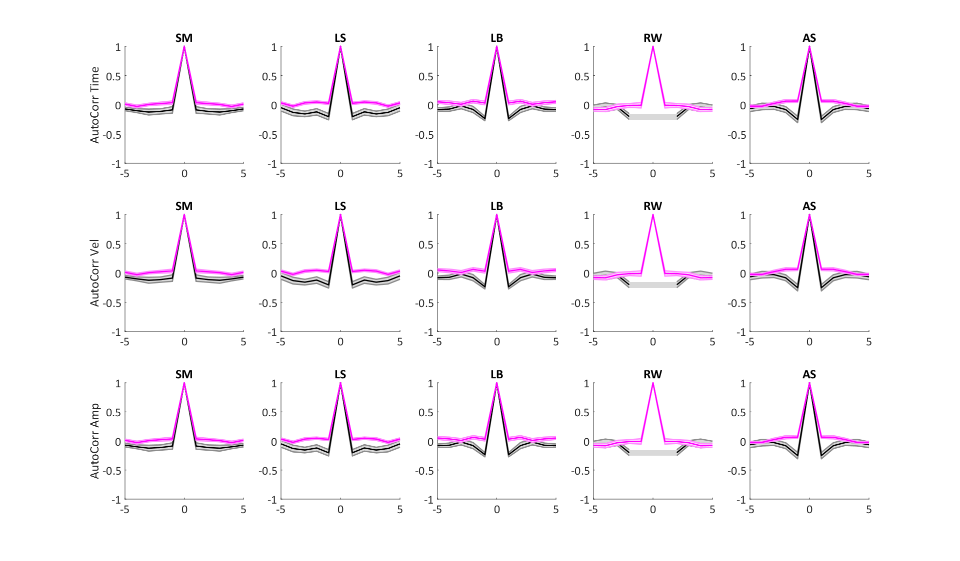
Auto correlation between drifts per trial in each condition

Slide 4
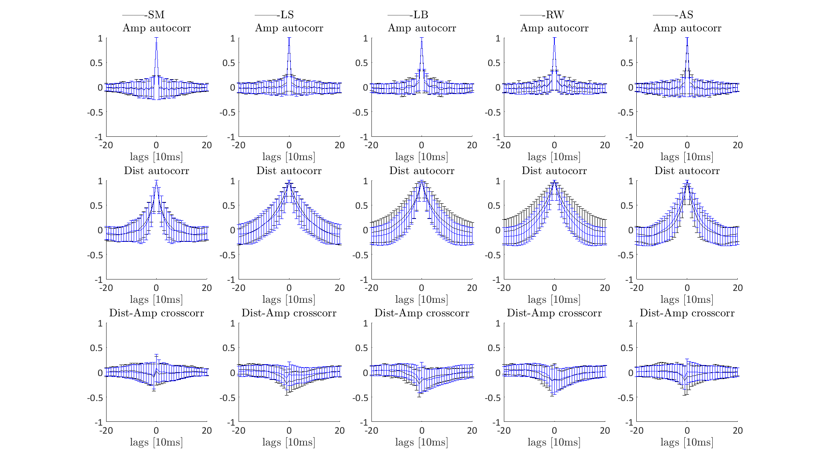
Auto correlation “inside” per drift in each condition

Slide 5
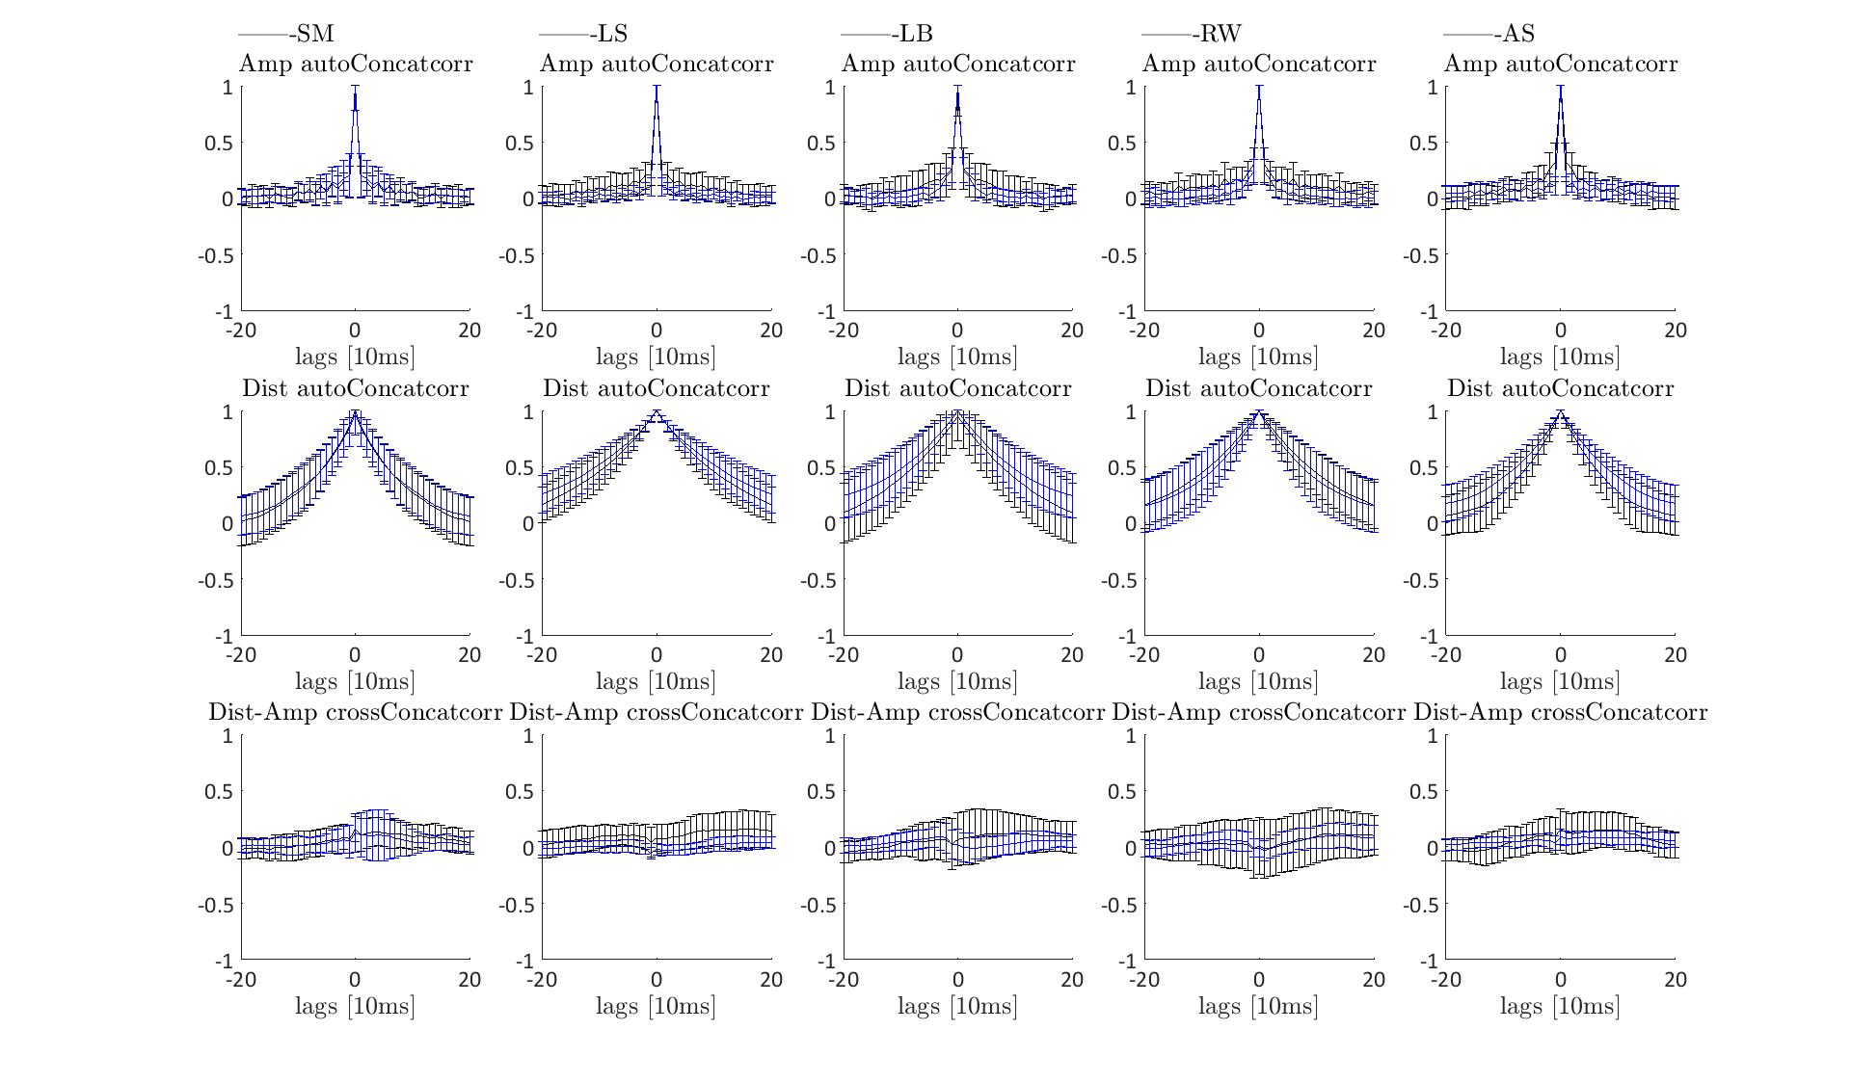
Same - concat

Slide 6
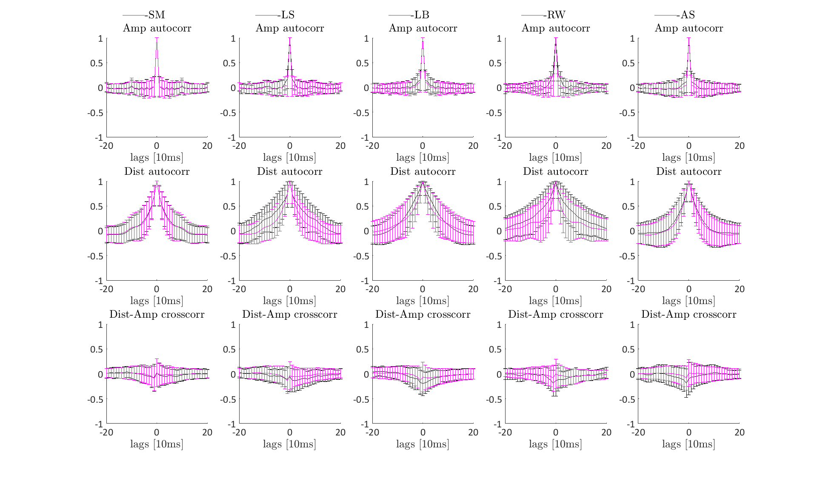
Auto correlation “inside” per drift in each condition

Slide 7
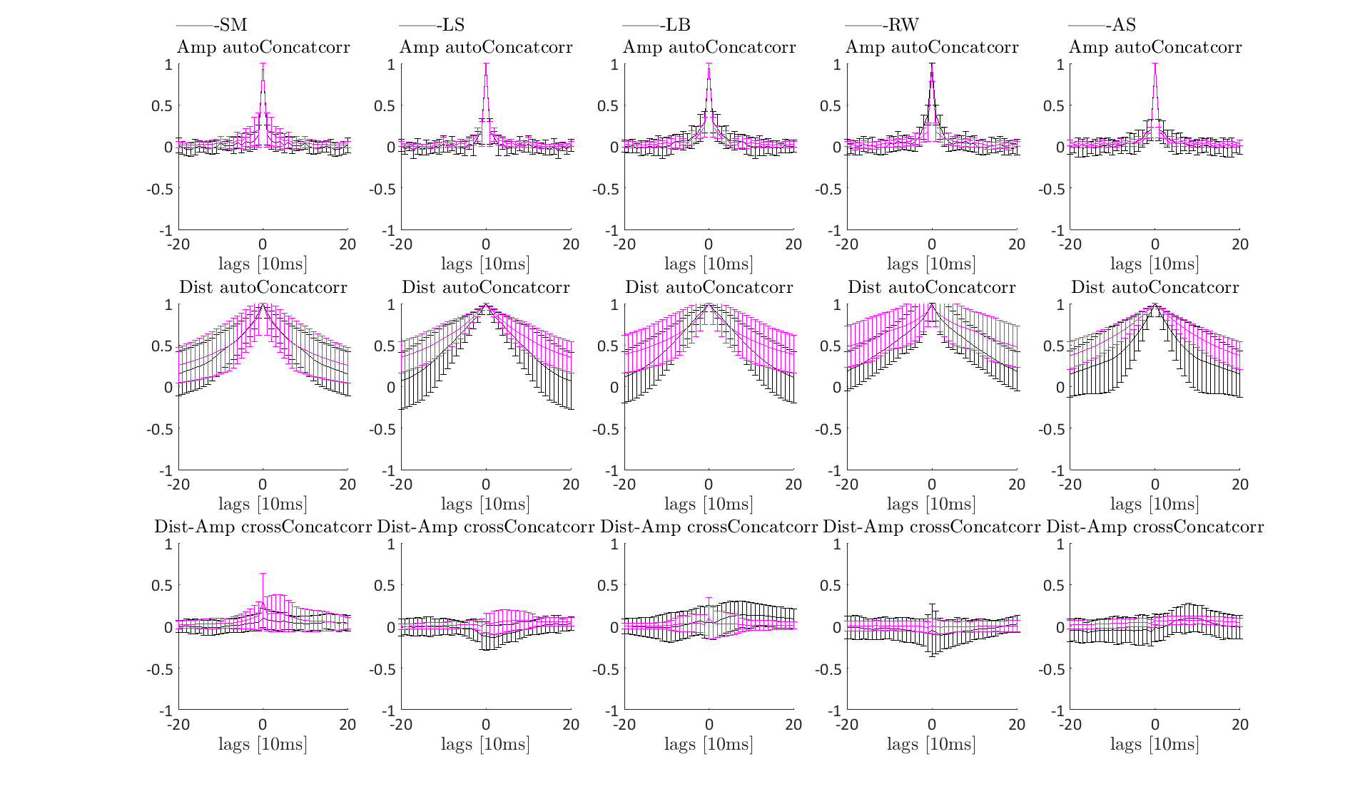
Same - concat

Slide 8
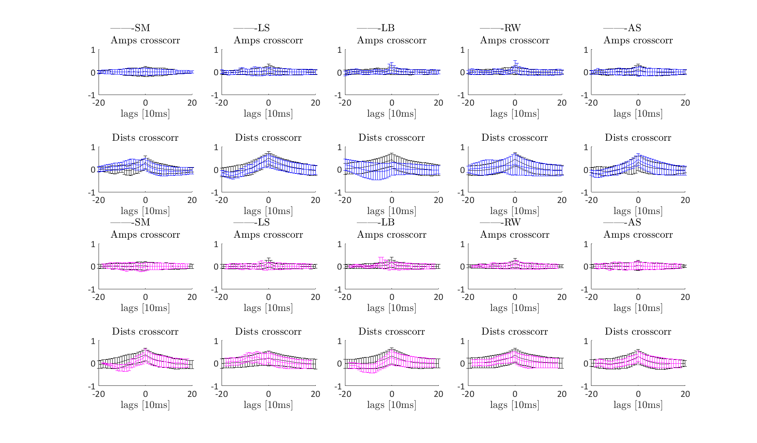
Cross-correlation “inside” per drift in each condition

